Slide 1
Basic calculations Variables

Slide 2
Arithmetic examples
compute the circumference and area of a circle with radius 2.5
$$\text{circumference}=2πr$$
$$\text{area}=πr^{2}$$

Slide 3
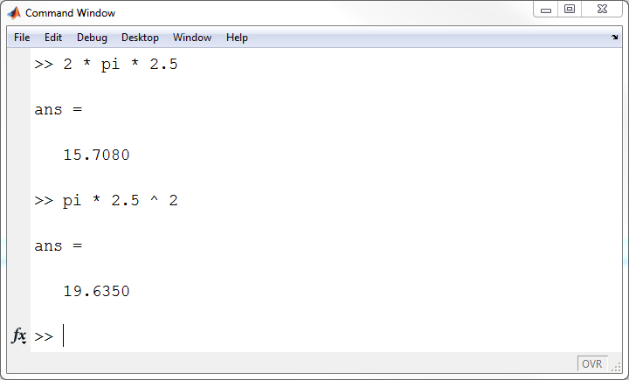
why only 4 digits after the decimal?

Slide 4
Arithmetic examples
Matlab computes values using 15-17 significant digits
by default, Matlab displays values between -1000 and 1000 using 4 digits after the decimal place
for values outside this range Matlab will use scientific notation
you can change this using the format command

Slide 5
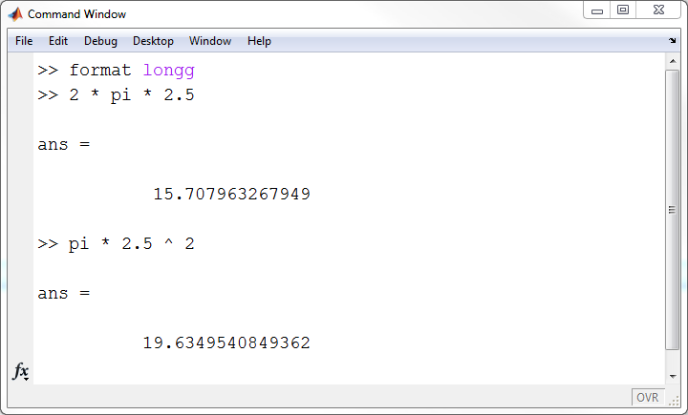

Slide 6

Arithmetic examples
A ball at rest is dropped from the top of a building. How far has the ball travelled when it reaches a velocity of 10 m/s (ignoring the effects of drag)?
$$\text{distance}=\frac{v^{2}}{2g}$$

Slide 7
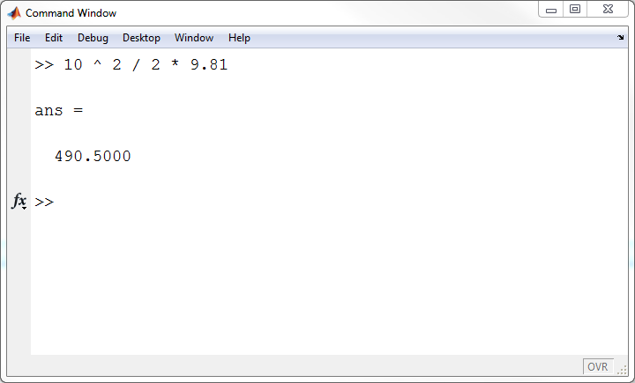
that can't be right

Slide 8
Arithmetic examples
our previous attempt contains a precedence error
we've actually computed
this is a very common error
if the denominator contains a sum, difference, product, or quotient, it probably needs to be enclosed by parentheses
$$\text{distance}=\left(\frac{{10}^{2}}{2}\right)9.81$$

Slide 9
Arithmetic examples
when computing anything you should always examine the result critically
whenever you get a wrong answer, it is probably not Matlab's fault
in this case, Matlab computed exactly what we asked it to
we just happened to ask Matlab to compute the wrong expression

Slide 10
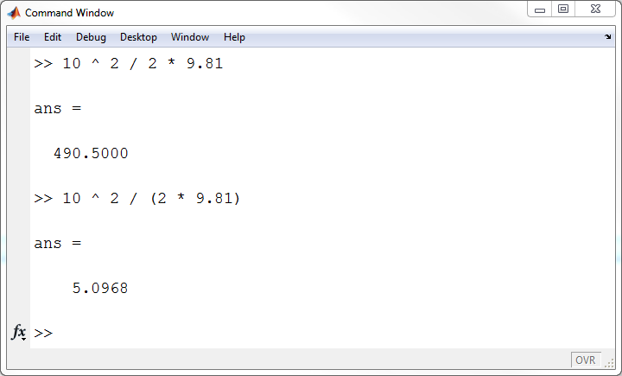
that seems more sensible

Slide 11
Trigonometry example
the free-body diagram for an object having mass 1.1 kg is shown below. Compute the net horizontal and vertical force acting on the object.
$$f=10N$$
$$30°$$
$$g$$

Slide 12
Trigonometry example
The standard solution is to find the components of the vector $f$
$$f=10N$$
$$f_{y}=10\sin\left(30°\right)$$
$$30°$$
$$f_{x}=10\cos\left(30°\right)$$
$$g$$

Slide 13
Functions
Matlab provides functions named sin and cos to compute the sine and cosine of an angle
a function provides the Matlab programmer a way to perform a well-defined task using a well-defined interface
interface
function name
inputs to the function
outputs of the function

Slide 14
Functions
the function interface is documented through a built-in help mechanism
to use the built-in help type help function-name or doc function-name where function-name is the name of the function

Slide 15
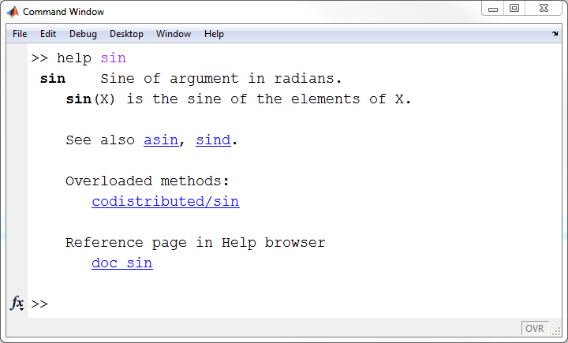

Slide 16
Functions
the input to the sin function is the angle
the input goes inside parentheses after the function name
the output is the sine of the angle
which is just a value

Slide 17
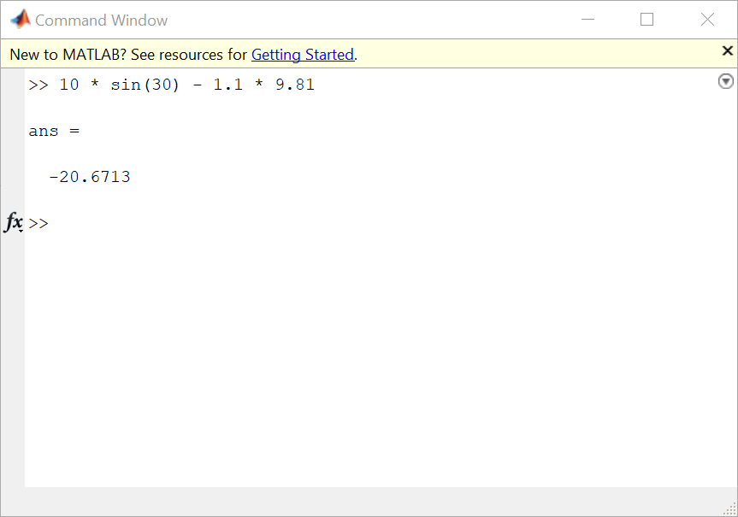
that can't be right

Slide 19
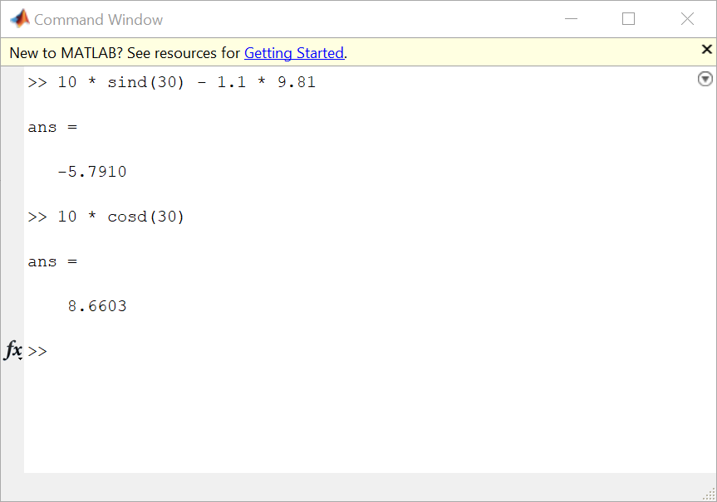

Slide 20
Elementary mathematical functions
Matlab has many elementary mathematical functions for trigonometry, exponents and logarithms, and rounding
to see the complete list type help elfun or doc elfun

Slide 21
Variables
except for trivial calculations, you will almost always want to store the result of a computation
a variable is a name given to a stored value; the statement: z = 1 + 2 causes the following to occur:
compute the value 1 + 2
store the result in the variable named z
MATLAB automatically creates z if it does not already exist
Note: The statement
1 + 2 = z
is an error in MATLAB

Slide 22
Variables
the = operator is the assignment operator
the statement: z = 1 + 2 means:
evaluate the expression on the right-hand side of =
store the result in the variable on the left-hand size of =
the word “store” means store in computer memory
Note: The statement
1 + 2 = z
is an error in MATLAB

Slide 23
A simple memory model
a memory model is useful for understanding some important programming concepts
our model is very simple:
a table with 3 columns
an address
starts at 1 and counts up by 1 for each row of the table
the variable name
only one variable per row
variable names must be unique in each workspace
the value stored
always a numeric value for our purposes
only one value per row

Slide 24
z = 1 + 2;
Address | Variable name | Value
1 | z | 3
2
3
4
5
6
...

Slide 25
Variable names
a variable name must start with a letter
the rest of the name can include letters, digits, or underscores
names are case sensitive, so A and a are two different variables
MATLAB has some reserved words called keywords that cannot be used as variable names
use the command iskeyword to get a list of keywords

Slide 26
Variable names
valid variable names | invalid variable names | reason invalid
x | $ | does not begin with a letter $ is not allowed in variable names
x6 | 6x | does not begin with a letter
lastValue | if | if is a keyword
pi_over_2 | pi/2 | / is not allowed in variable names

Slide 27
Advice on choosing variable names
use short, meaningful names
a name that conveys the purpose of the variable is often useful for others who need need to read your code, e.g., use massEarth instead of mE massSun instead of mS
exceptions to the rule:
if you are solving a problem that contains variable names, you should try to use the same names, e.g., in physics the following would likely be common: g, c, v0, h, hBar

Slide 28
Advice on choosing variable names
use lowerCamelCase for most variable names, e.g., use thetaRad instead of thetarad
avoid long names, e.g., use filteredData instead of measurementsFilteredToRemoveOutliers

Slide 29
More on variable assignment
remember that the statement: z = 1 + 2 means:
evaluate the expression on the right-hand side of =
store the result in the variable on the left-hand size of =

Slide 30
More on variable assignment
what is the result of the following assignment statements? z = 1 + 2; y = z; y = 4;
is the value of z equal to 3 or 4?
draw the memory diagram for each step

Slide 31
z = 1 + 2;
Address | Variable name | Value
1 | z | 3
2
3
4
5
6
...

Slide 32
y = z;
Address | Variable name | Value
1 | z | 3
2 | y | 3
3
4
5
6
...

Slide 33
y = 4;
Address | Variable name | Value
1 | z | 3
2 | y | 4
3
4
5
6
...

Slide 34
More on variable assignment
the statement: y = z; means:
evaluate the expression on the right-hand side of =
store the result in the variable on the left-hand size of =
it does not mean that y and z are the same variable

